Slide 1
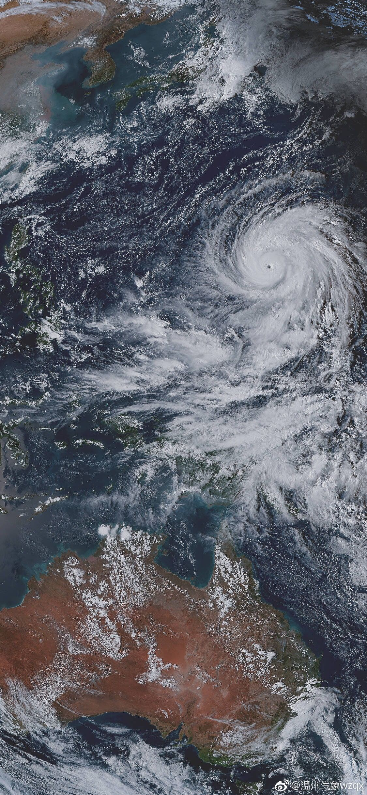
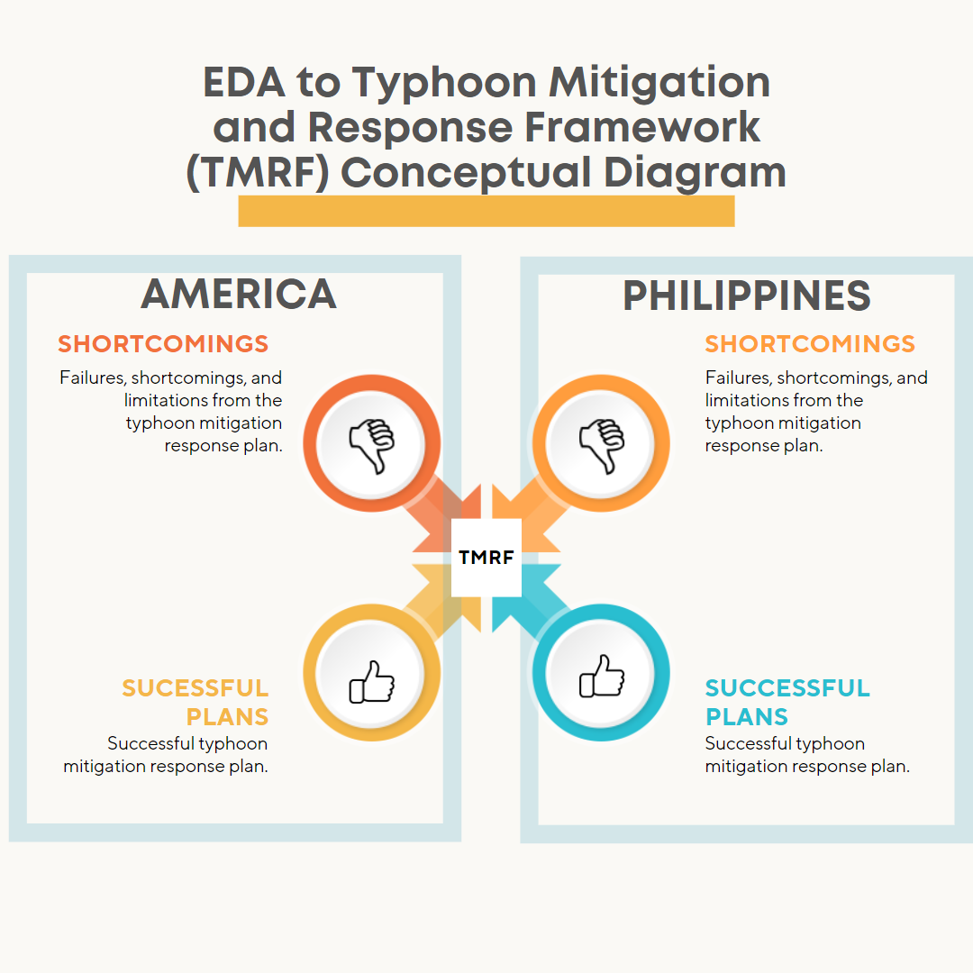
EDA to Typhoon Mitigation and Response Framework (TMRF)
Presented by:
TEAM TYPHOON ANALYST
Alvaro, Gabriel Edrian
Palis, John Arthur
Alangilan, Christine Joy
Guerra, Marian

Slide 2
DID YOU KNOW?
20
APPROXIMATELY
Twenty tropical cyclones pass through the Philippine Area of Responsibility per year

Slide 3

TOPICS AND HIGHLIGHTS
Sustainable Development Goals
Introduction
Problem Statement
Objectives
Purpose
Sources of Datasets

Slide 4
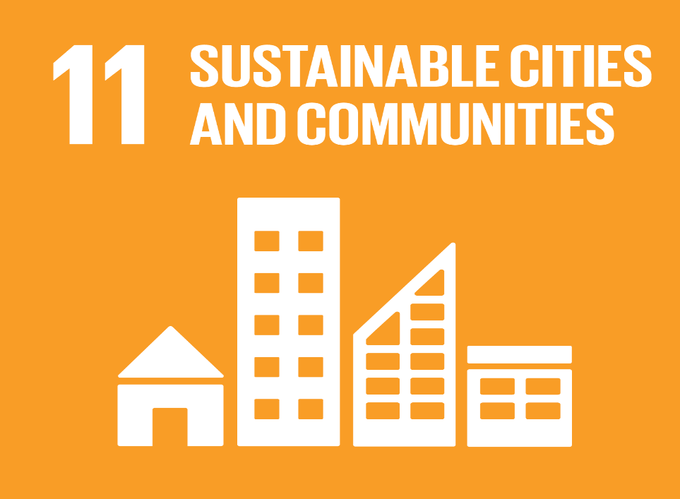


Goal 11: Sustainable Cities and Communities
Sustainable Development Goals
It stives to mitigate the negative consequences of natural catastrophes like typhoons.
Goal 13: Climate Action
It stives to take immediate action to address climate change and its consequences.
Goal 15: Life on Land
It seeks to manage forest sustainability, prevent desertification, halt and reverse land degradation, and halt biodiversity loss.

Slide 5
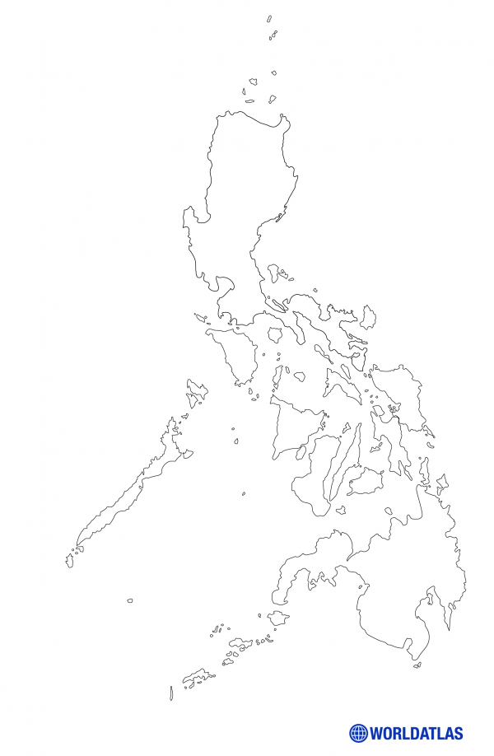
EDA TO TMRF INTRODUCTION
The Philippines' apparent vulnerability to natural disasters emerges from its geographic location within the Pacific Ring of Fire.

Slide 6
PROBLEM STATEMENT
The primary issue addressed by this project is the lack of a mitigation and response framework among the cities and municipalities located throughout the Philippine archipelago.

Slide 7
OBJECTIVES
The HDX or The Humanitarian Data Exchange is an open platform for exchanging data between humanitarian organizations and disasters. HDX, launched in July 2014, aims to make humanitarian data more accessible and usable for research.
Humanitarian Data Exchange Data set about Philippines (2019)
Objective 1
Objective 2
Objective 3
The Centre for Research on the Epidemiology of Disasters' Data set about the American Typhoons (2000-2022)

Slide 8


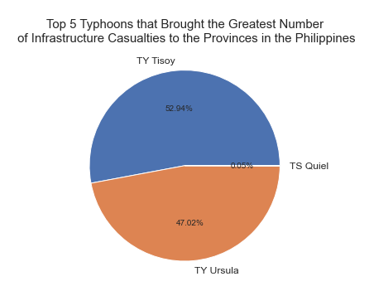
OBJECTIVES
TYPHOON TISOY
68,104
TYPHOON TISOY TYPHOON URSULA
TYPHOON QUIEL
Totally Damaged Houses
Humanitarian Data Exchange Data set about Philippines (2019)
Objective 1
Objective 2
Objective 3
The Centre for Research on the Epidemiology of Disasters' Data set about the American Typhoons (2000-2022)

Slide 9

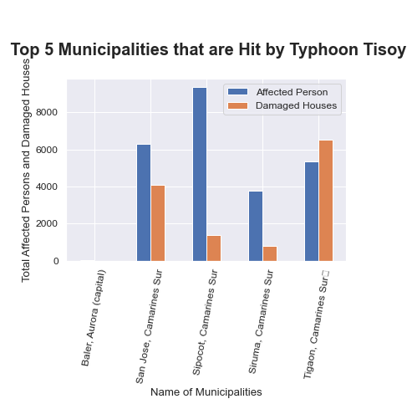
OBJECTIVES
SIPOCOT, CAMARINES SUR
TYPHOON TISOY TYPHOON URSULA
TYPHOON QUIEL
136.0
Totally Damaged Houses
Humanitarian Data Exchange Data set about Philippines (2019)
Objective 1
Objective 2
Objective 3
The Centre for Research on the Epidemiology of Disasters' Data set about the American Typhoons (2000-2022)

Slide 10
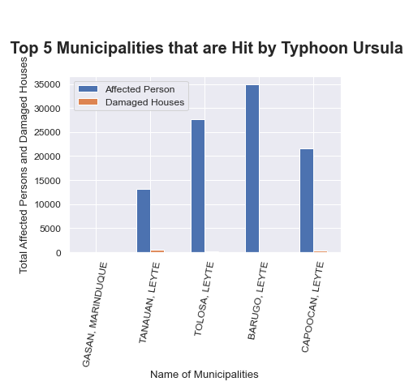


OBJECTIVES
34932.0
34932.0
Humanitarian Data Exchange Data set about Philippines (2019)
Objective 1
Objective 2
Objective 3
The Centre for Research on the Epidemiology of Disasters' Data set about the American Typhoons (2000-2022)
Barugo, Leyte
34932.0
TYPHOON URSULA
Barugo, Leyte
Total Affected Persons
Most affected Municipality

Slide 11
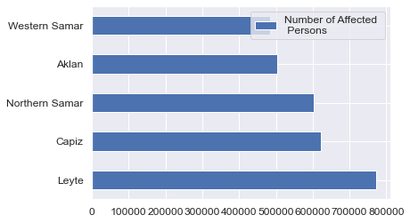


OBJECTIVES
Humanitarian Data Exchange Data set about Philippines (2019)
Objective 1
Objective 2
Objective 3
The Centre for Research on the Epidemiology of Disasters' Data set about the American Typhoons (2000-2022)
LEYTE
WESTERN SAMAR
772162.0
483308.0
AFFECTED INDIVIDUALS
AFFECTED INDIVIDUALS

Slide 12
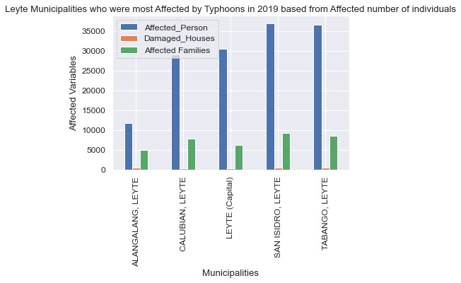
OBJECTIVES
Humanitarian Data Exchange Data set about Philippines (2019)
Objective 1
Objective 2
Objective 3
The Centre for Research on the Epidemiology of Disasters' Data set about the American Typhoons (2000-2022)
SAN, ISIDRO, LEYTE
ALANGALANG, LEYTE
36980.0
11680.0
AFFECTED INDIVIDUALS
AFFECTED INDIVIDUALS

Slide 13
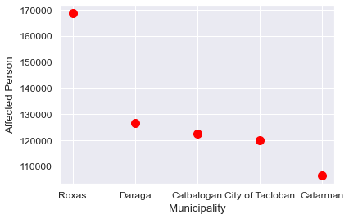
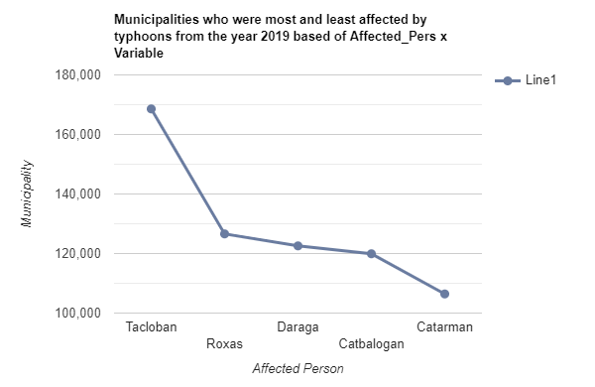
OBJECTIVES
Humanitarian Data Exchange Data set about Philippines (2019)
Objective 1
Objective 2
Objective 3
The Centre for Research on the Epidemiology of Disasters' Data set about the American Typhoons (2000-2022)
TOP 5
MUNICIPALITIES
Who had the most affected individuals in the year 2019

Slide 14
OBJECTIVES
Humanitarian Data Exchange Data set about Philippines (2019)
The Centre for Research on the Epidemiology of Disasters' Data set about the American Typhoons (2000-2022)
Objective 1
Objective 2
Objective 3
Objective 4
Objective 5

Slide 15
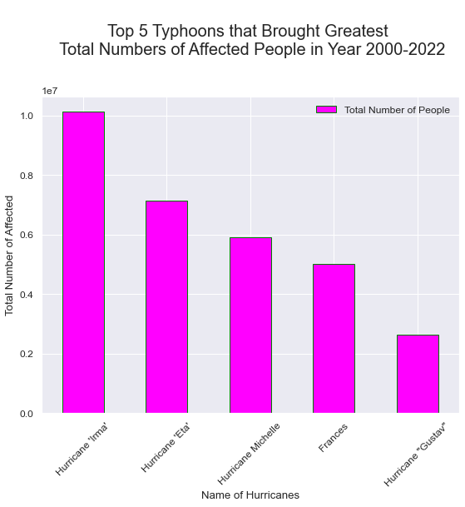
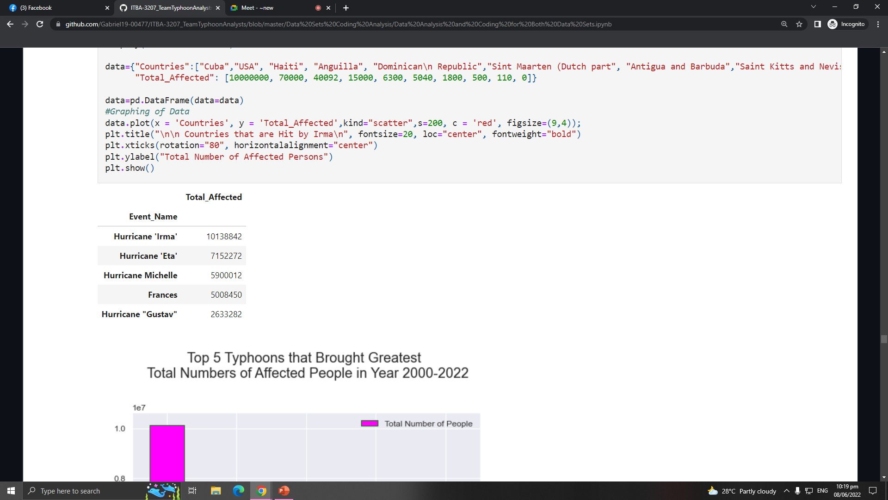

OBJECTIVES
Humanitarian Data Exchange Data set about Philippines (2019)
The Centre for Research on the Epidemiology of Disasters' Data set about the American Typhoons (2000-2022)
Objective 1
Objective 2
Objective 3
Objective 4
Objective 5
HURRICANE
IRMA

Slide 16
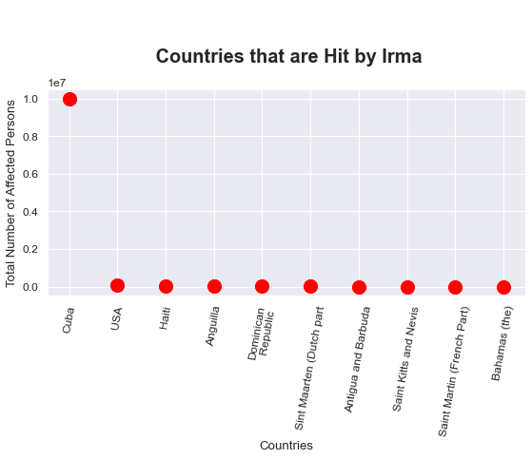
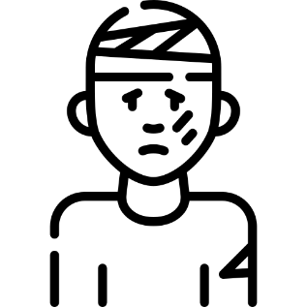
OBJECTIVES
Humanitarian Data Exchange Data set about Philippines (2019)
The Centre for Research on the Epidemiology of Disasters' Data set about the American Typhoons (2000-2022)
Objective 1
Objective 2
Objective 3
Objective 4
Objective 5
10M
HURRICANE IRMA
TOTAL AFFECTED PERSON IN CUBA BY THE HURRICANE IRMA

Slide 17
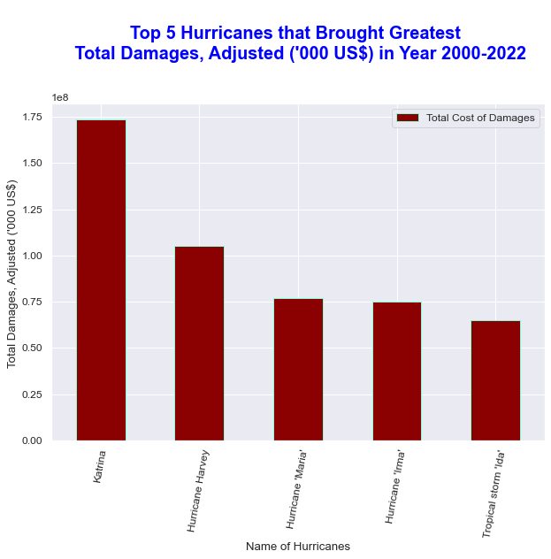
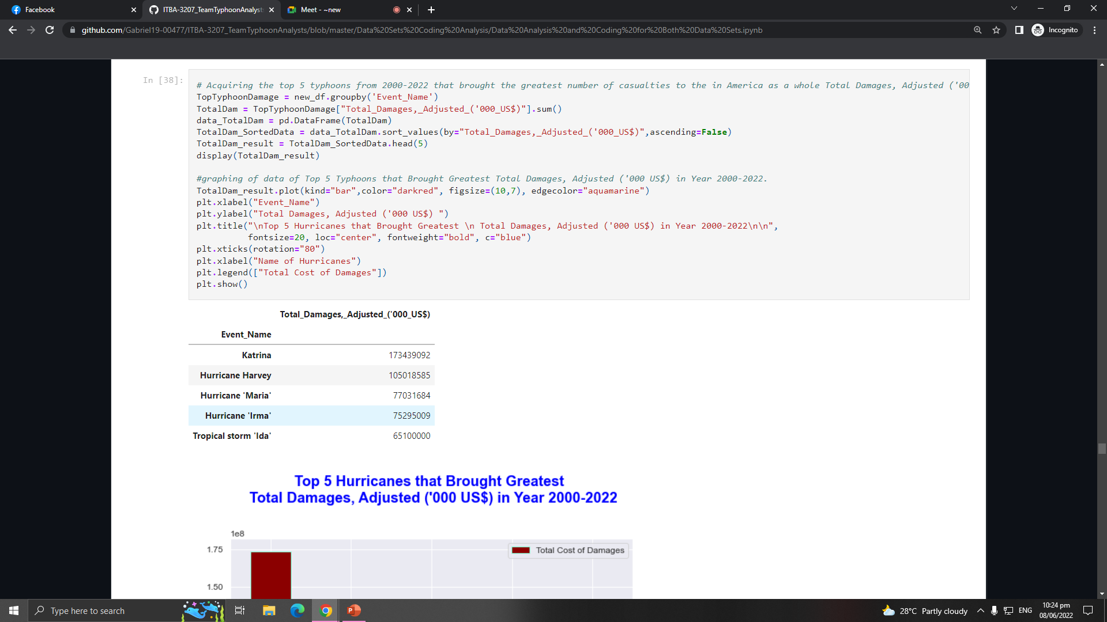
OBJECTIVES
Humanitarian Data Exchange Data set about Philippines (2019)
The Centre for Research on the Epidemiology of Disasters' Data set about the American Typhoons (2000-2022)
Objective 1
Objective 2
Objective 3
Objective 4
Objective 5
HURRICANE
KATRINA

Slide 18
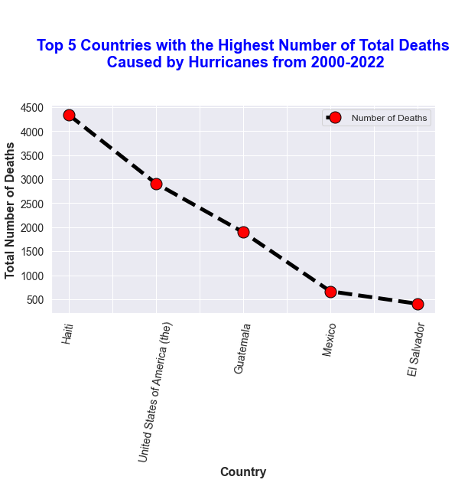
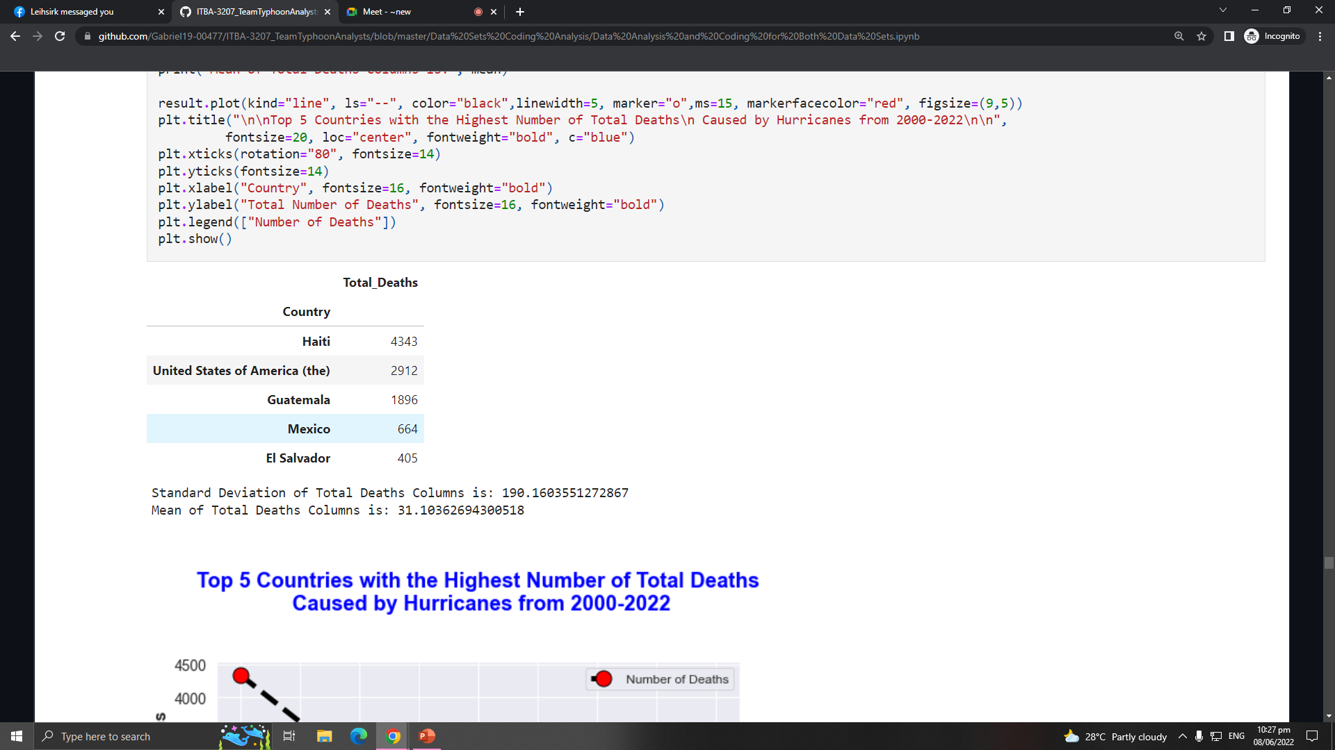
OBJECTIVES
Humanitarian Data Exchange Data set about Philippines (2019)
The Centre for Research on the Epidemiology of Disasters' Data set about the American Typhoons (2000-2022)
Objective 1
Objective 2
Objective 3
Objective 4
Objective 5
HAITI
4343
TOTAL DEATHS

Slide 19
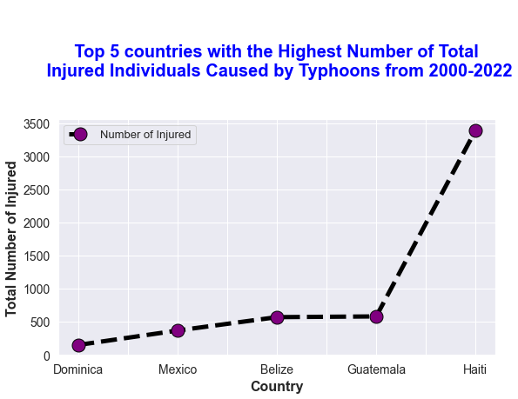
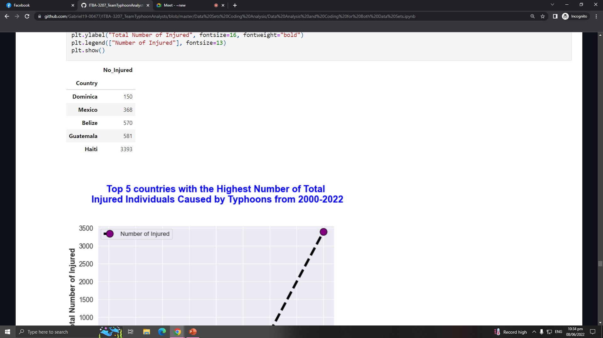

OBJECTIVES
Humanitarian Data Exchange Data set about Philippines (2019)
The Centre for Research on the Epidemiology of Disasters' Data set about the American Typhoons (2000-2022)
Objective 1
Objective 2
Objective 3
Objective 4
Objective 5
3393
150
NUMBER OF INJURED IN HAITI
NUMBER OF INJURED IN DOMINICA

Slide 20
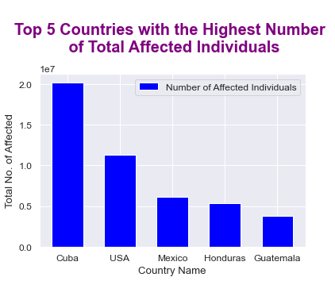
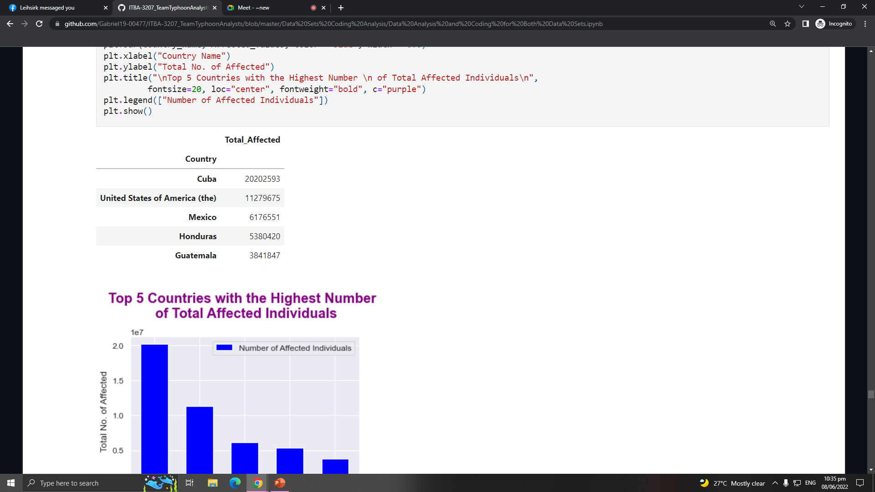
OBJECTIVES
Humanitarian Data Exchange Data set about Philippines (2019)
The Centre for Research on the Epidemiology of Disasters' Data set about the American Typhoons (2000-2022)
Objective 1
Objective 2
Objective 3
Objective 4
Objective 5
20202593.0
TOTAL AFFECTED INDIVIDUALS IN CUBA

Slide 21
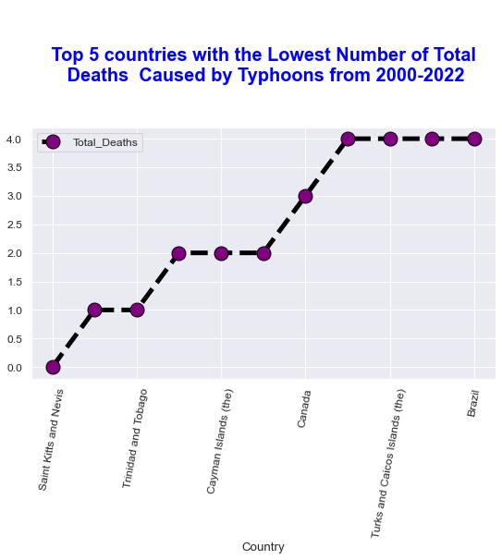
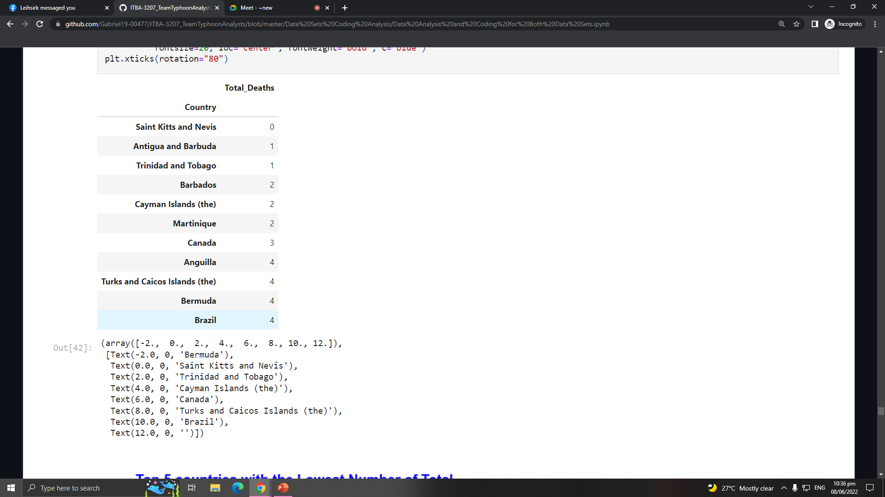
OBJECTIVES
Humanitarian Data Exchange Data set about Philippines (2019)
The Centre for Research on the Epidemiology of Disasters' Data set about the American Typhoons (2000-2022)
Objective 1
Objective 2
Objective 3
Objective 4
Objective 5
Saint Kitts and Nevis
Lowest Number of Total Deaths

Slide 22
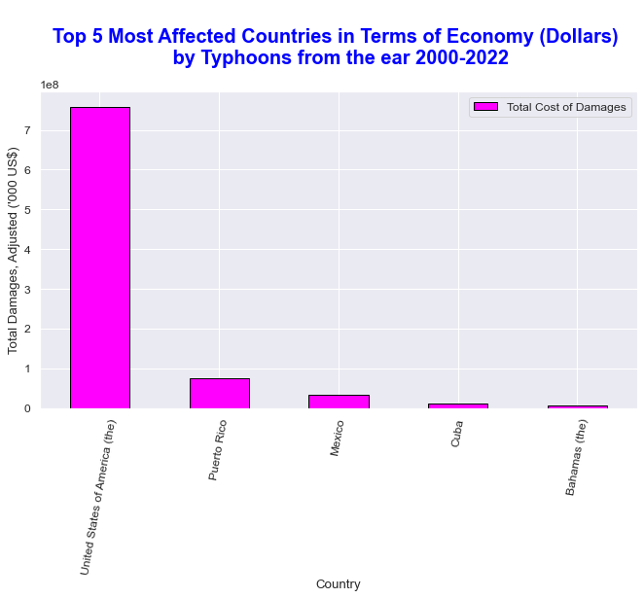
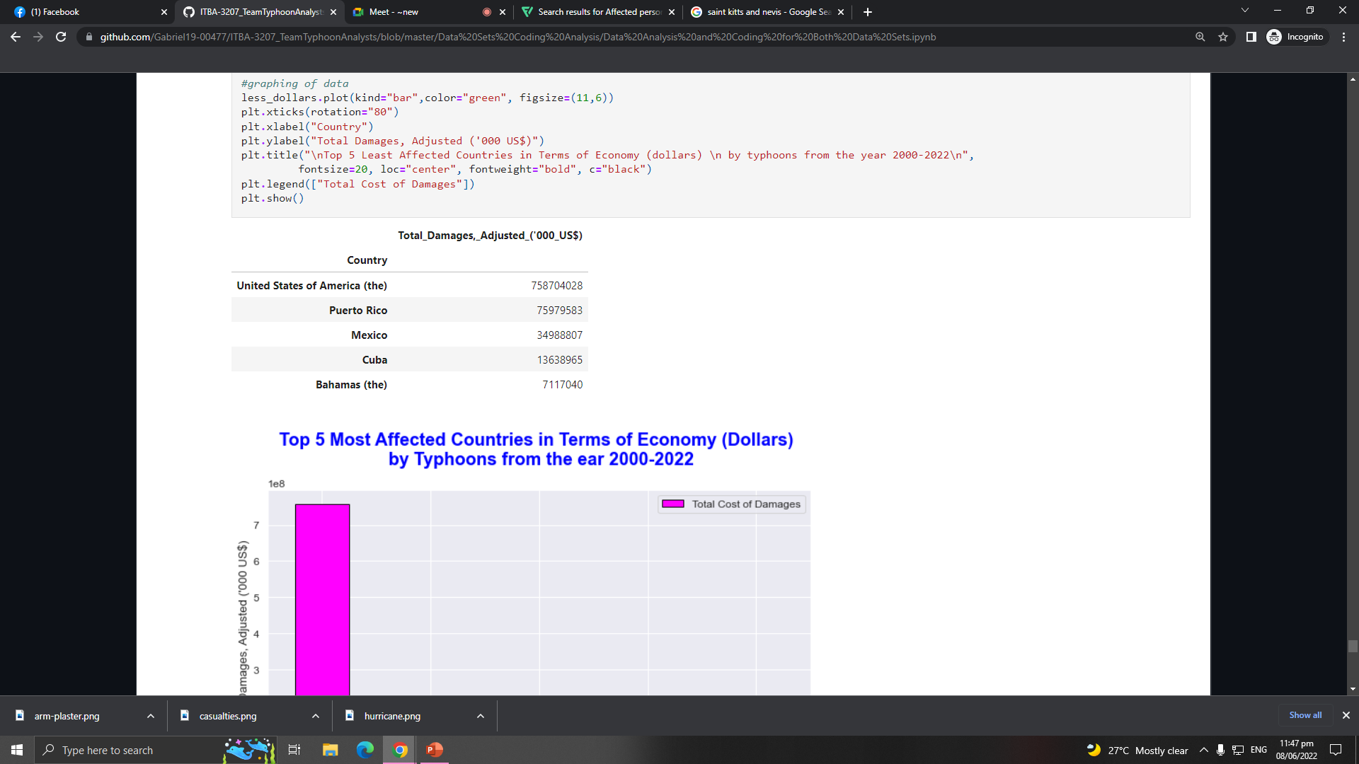
OBJECTIVES
Humanitarian Data Exchange Data set about Philippines (2019)
The Centre for Research on the Epidemiology of Disasters' Data set about the American Typhoons (2000-2022)
Objective 1
Objective 2
Objective 3
Objective 4
Objective 5
USA
MOST AFFECTED COUNTRY HAVING MORE THAN 700 BILLION TOTAL COST OF DAMAGES

Slide 23
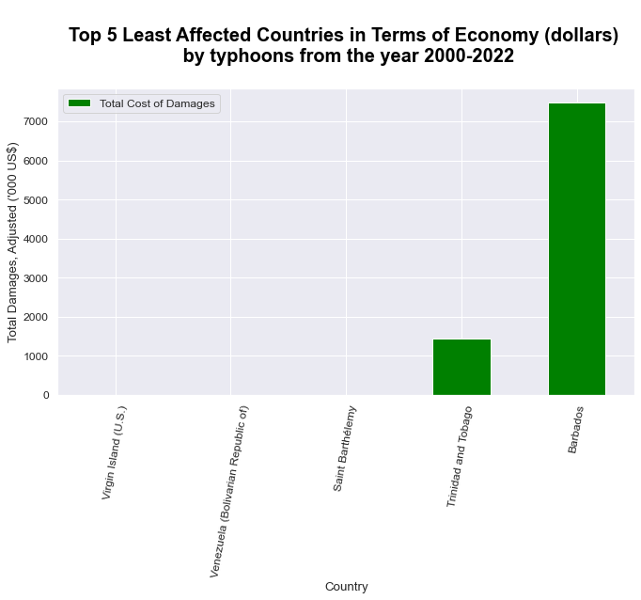
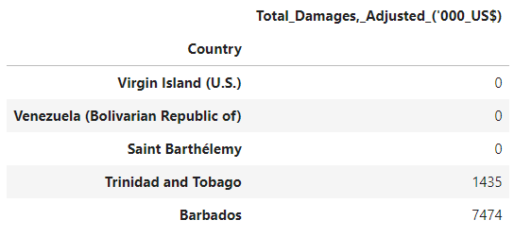
OBJECTIVES
Humanitarian Data Exchange Data set about Philippines (2019)
The Centre for Research on the Epidemiology of Disasters' Data set about the American Typhoons (2000-2022)
Objective 1
Objective 2
Objective 3
Objective 4
Objective 5
Virgin Islands, Venezuela, and Saint Barthelemy
No Record of Total Cost of Damages

Slide 24
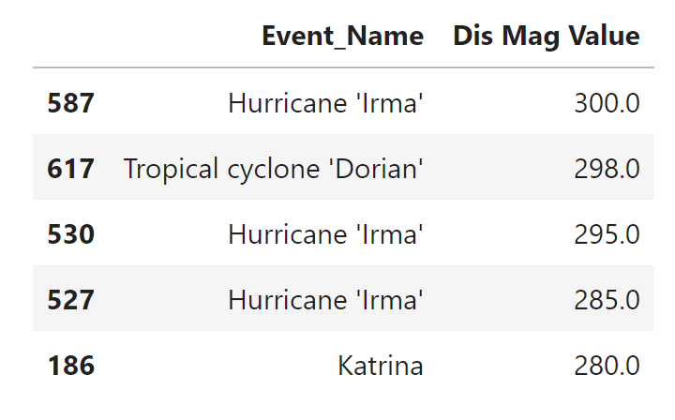
OBJECTIVES
Humanitarian Data Exchange Data set about Philippines (2019)
The Centre for Research on the Epidemiology of Disasters' Data set about the American Typhoons (2000-2022)
Objective 1
Objective 2
Objective 3
Objective 4
Objective 5

Slide 25


Source of Datasets
HDX
An open platform for sharing data across crises and organizations and goal of it to make humanitarian data easy to find and use for analysis.
CRED
The Centre promotes research, training and technical expertise on humanitarian emergencies, particularly in public health and epidemiology.

Slide 27



MEET THE TEAM
TEAM TYPHOON ANALYST
Gabriel Alvaro
Project Manager
John Palis
Presentation Manager
Christine Alangilan
Documentation Director
Marian Guerra
Quality Assurance Analyst

